Slide 1
Dirichlet Processes
An Introduction to nonparametric bayesian models

Slide 2
Nonparametric Models
A nonparametric model is a model which does not need an explicitly specified number of parameters
Consider the problem of mapping entity labels to entity references in a document, with an unknown number of entities
Dirichlet processes can be used to solve this problem in a principled, Bayesian fashion

Slide 3
Dirichlet Distribution

Slide 4
Consider a weighted dice…
How do we estimate the probability of a given bias?
The bias is itself a distribution over outcomes
Given a set of observations E, our estimate would be:
Or in general:

Slide 5
The Dirichlet Distribution
Note that this is a distribution over distributions

Slide 6
Bayes Rule
Suppose P ~ Dir(a) is our prior the possible biases for the die
What happens after we roll the die again?

Slide 7
Bayes Rule

Slide 8
Conjugate Prior
If our prior is Dir(α) and we observe n, the posterior is Dir(α+n)
The Dirichlet Distribution is called the “conjugate prior” to the multinomial distribution
If we have a Dirichlet prior and a multinomial likelihood, we obtain a Dirichlet posterior

Slide 9
Summary
The Dirichlet Distribution is a distribution over distributions
It is the conjugate prior to the multinomial
The more we observe a given outcome the more likely it becomes in the posterior

Slide 10
Polya Urn Scheme

Slide 11
Polya Urn Scheme
The Polya Urn Scheme is a model that is helpful for understanding both the Dirichlet Distribution and Dirichlet Process
Consider an urn with balls of various colours…

Slide 12
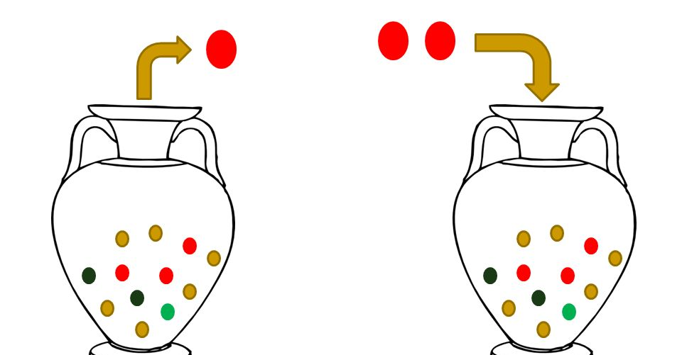
Polya Urn Scheme

Slide 13
Polya Urn Scheme
# balls of colour c initially ⬄
# balls of colour c drawn ⬄
distribution of balls in the urn ⬄
distribution over all colour distributions ⬄

Slide 14
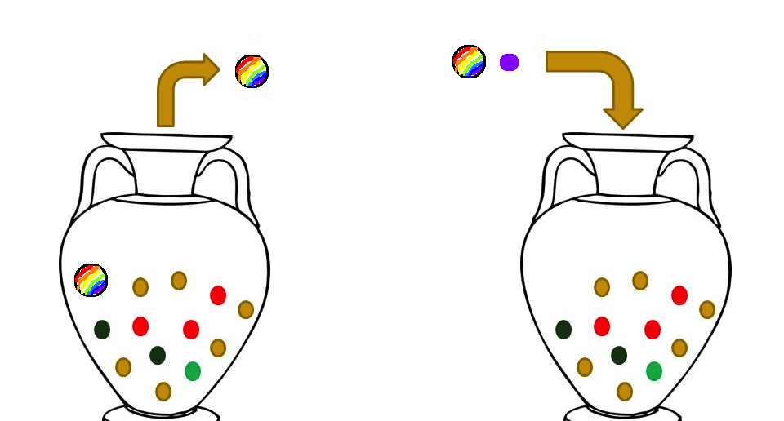
Taking this a step further…

Slide 15
Blackwell-MacQueen Urn Scheme
The urn begins with no balls except the marked ball
Drawing the marked ball always has probability ~α
If we draw the marked ball, we add a new ball of a colour sampled from a distribution G₀
This now converges to a sample from the Dirichlet Process DP(α, G₀)

Slide 16
Chinese Restaurant Process
Consider a similar model, with patrons at tables in a restaurant instead of of balls in an urn
Colours ⬄ table labels (drawn from G₀)
Balls ⬄ patrons
Drawing balls ⬄ new patrons arriving
Also converges to sample from DP

Slide 17
Chinese Restaurant Process

Slide 18
Dirichlet Process
The Dirichlet Process (DP) is essentially a limiting form of the Dirichlet distribution
It is a distribution over distributions over an unbounded number of possible outcomes instead of a finite number
In spite of this, samples from a DP are always finite discrete distributions

Slide 19
Dirichlet Mixture Models

Slide 20
Consider a mixture model…
Given data {x} independently drawn from unknown distributions
All unknown distributions from same class but different parameters
Prior over distribution of group parameters is Dirichlet

Slide 21
Dirichlet Mixture Model
R.M. Neal. Markov chain sampling methods for Dirichlet process mixture models. Journal of Computational and Graphical Statistics, 9:249–265, 2000.

Slide 22
As a generative model:
Given a model with known parameters:
Sample a distribution G from DP(α,G₀)
For each data point x_{i}:
Sample parameters θ_{i} from G
Sample x_{i} from F(θ_{i})
Note that this is equivalent to using a Chinese Restaurant Process or Urn Scheme (and in practice we would use one of those to implement this)

Slide 23
Inference
To make an inference based on existing data using this model, we perform Gibbs Sampling
Gibbs Sampling is a Markov Chain Monte Carlo (MCMC) method which uses conditional probabilities to iteratively approximate a distribution

Slide 24
Gibbs Sampling
Say we want to sample from P(A,B,C), but cannot do so directly
However, we CAN sample from P(A|B, C), P(B|A, C), etc…
Then, perform the following iterative algorithm:
For t=1 to T
Fix B, C
Sample A ~ P(A|B, C)
Repeat to sample B and C using their conditional distributions
This will converge to a sample from P(A,B,C)

Slide 25
Modified Dirichlet Mixture Model
R.M. Neal. Markov chain sampling methods for Dirichlet process mixture models. Journal of Computational and Graphical Statistics, 9:249–265, 2000.

Slide 26
Conditional Class Probabilities
In the limit as K -> ∞, the conditional probabilities approach the CRP probabilities:
R.M. Neal. Markov chain sampling methods for Dirichlet process mixture models. Journal of Computational and Graphical Statistics, 9:249–265, 2000.

Slide 27
Hierarchical Dirichlet Processes

Slide 28
Hierarchical Dirichlet Process
In the Hierarchical Dirichlet Process (HDP) model, we consider G₀ itself to be a sample from DP(γ, H)
HDP motivation: J groups of data, with each group a mixture model over the same mixture components
HDP best represented by the Chinese Restaurant Franchise model (CRF)
R.M. Neal. Markov chain sampling methods for Dirichlet process mixture models. Journal of Computational and Graphical Statistics, 9:249–265, 2000.

Slide 29
Hierarchical Dirichlet Process
Yee Whye Teh, Michael Jordan, Matthew Beal, and David Blei. 2006. Hierarchical dirichlet processes. Journal of the Amer-
ican Statistical Association, 101.

Slide 30
Chinese Restaurant Franchise: Introduction
Franchise with J restaurants, with a shared menu across restaurants
Each table has one dish ordered by the first customer who sits there, shared among all customers at that table (Multiple tables can serve the same dish)
Customers sit at tables at each restaurants according to the regular CRP

Slide 31
Chinese Restaurant Franchise: Definitions
Each ψ_{jt} is associated with one θ_{k}, and k_{jt} is the index associated with it (ψ_{jt}s not necessarily distinct)
Each ϕ_{ji} is associated with one ψ_{jt}
n_{jt} is the number of ϕ_{ji}s associated with one ψ_{jt}
m_{jk} is the number of ψ_{jt}s associated with one θ_{k}
m_{k} is the sum over all j of m_{jk}

Slide 32
Chinese Restaurant Franchise: Associations
J groups of data ⬄ J restaurants
ϕ_{ji} ⬄ dish eaten by customer j,i
ψ_{jt} ⬄ dish served at table j,t
θ_{k} ⬄ dish with label k
n_{jt} ⬄ number of customers at each table
m_{jk} ⬄ number of customers eating each dish
t_{ji} ⬄ label for table of customer j,i
k_{jt} ⬄ label for dish of table j,t

Slide 33
Conditional Probabilities
(1)
Marginalize out G₀ as follows, defining ψ_{-(jt)} as {ψ₁₁, ψ₁₂,…, ψ₂₁, …ψ_{jt-1},}
(2)
δ_{θ} corresponds to the point mass concentrated at θ
Yee Whye Teh, Michael Jordan, Matthew Beal, and David Blei. 2006. Hierarchical dirichlet processes. Journal of the Amer-
ican Statistical Association, 101.

Slide 34
Conditional Probabilities
In either equation, the first term corresponds to choosing an existing table/dish, and the second to increasing k or T_{j} and sampling a new table/dish
To find ϕ_{ji} we sample from (1)
To generate a new sample from G₀ we use (2) to obtain a sample ψ_{jt} and set ϕ_{ji} =ψ_{jt}
We have now fully marginalized out G₀ from the model

Slide 35
Sampling
We consider eqs. 1 and 2 expressed in terms of t_{ji} and k_{jt}
The conditionals for t are:
(t new)
(t prev)
Yee Whye Teh, Michael Jordan, Matthew Beal, and David Blei. 2006. Hierarchical dirichlet processes. Journal of the Amer-
ican Statistical Association, 101.

Slide 36
Sampling
For k, the conditionals are:
(k new)
(k prev)
Yee Whye Teh, Michael Jordan, Matthew Beal, and David Blei. 2006. Hierarchical dirichlet processes. Journal of the Amer-
ican Statistical Association, 101.

Slide 37
Sampling
For θ the conditional is:
where h(θ) refers to the density of H at θ
If H is conjugate to F, θ can be integrated out
Yee Whye Teh, Michael Jordan, Matthew Beal, and David Blei. 2006. Hierarchical dirichlet processes. Journal of the Amer-
ican Statistical Association, 101.

Slide 38
Applications

Slide 39
Coreference Resolution
Consider a corpus of documents containing references to some unknown set of entities
Suppose we know which words in the documents are entity references, but not which entities they reference – or even how many entities there are total
How do we infer a set of entity labels to find which words reference the same entities?

Slide 40
CRF model for Coreference
J groups of data ⬄ J documents
ϕ_{ji} ⬄ parameter set for mention j,i
ψ_{jt} ⬄ parameter set for entity j,t
θ_{k} ⬄ parameters with label k
n_{jt} ⬄ number of mentions of each entity
m_{jk} ⬄ number of mentions of each parameter set
t_{ji} ⬄ label for entity associated with mention j,i
k_{jt} ⬄ label for parameter set associated with entity j,t

Slide 41
Results
Results on the MUC dataset compared to a more recent paper:
 | Precision | Recall | F1
HDP model | 80.8 | 52.8 | 63.9
Lee et al | 81.2 | 73.6 | 77.2
Aria Haghighi and Dan Klein. 2007. Unsupervised coreference resolution in a nonparametric bayesian model. In Proceedings of the Association for Computational Linguistics.
K. Lee, L. He, M. Lewis, and L. Zettlemoyer. End-to-end Neural Coreference Resolution.ArXiv e-prints, Jul 2017

